Slide 1

GROUP 20
Medical Cost
Optimization
Convex Optimization for Healthcare Cost Management
Ch Bavesh Sai Satya Prakash
Guravana Lakshmi Narayana Naidu
Thangella Jeevantej

Slide 2
Problem Statement
Research Question: How can we optimize patient inclusion and policy decisions to minimize predicted medical charges while maximizing insurer profitability?
Problem 1
Problem 2
Minimize Predicted Medical Charges
Maximize Expected Profit
  Risk Minimization
  Linear Programming (LP) formulation
  Clinically feasible patient constraints
  Revenue minus predicted charges
  Premium = 0.15 × Charges + $600
  Quasi-convex nonlinear program (L-BFGS-B)

Slide 3
Dataset Overview
1,338
6
0
Patient Records
Features
Missing Values
Variable | Type | Description
age | Integer | Patient age (18–64 years)
sex | Categorical | Patient sex (male / female)
bmi | Float | Body Mass Index (kg/m²)
children | Integer | Number of dependents
smoker | Categorical | Smoker status (yes / no)
charges | Float | Annual medical charges (USD) — TARGET

Slide 4
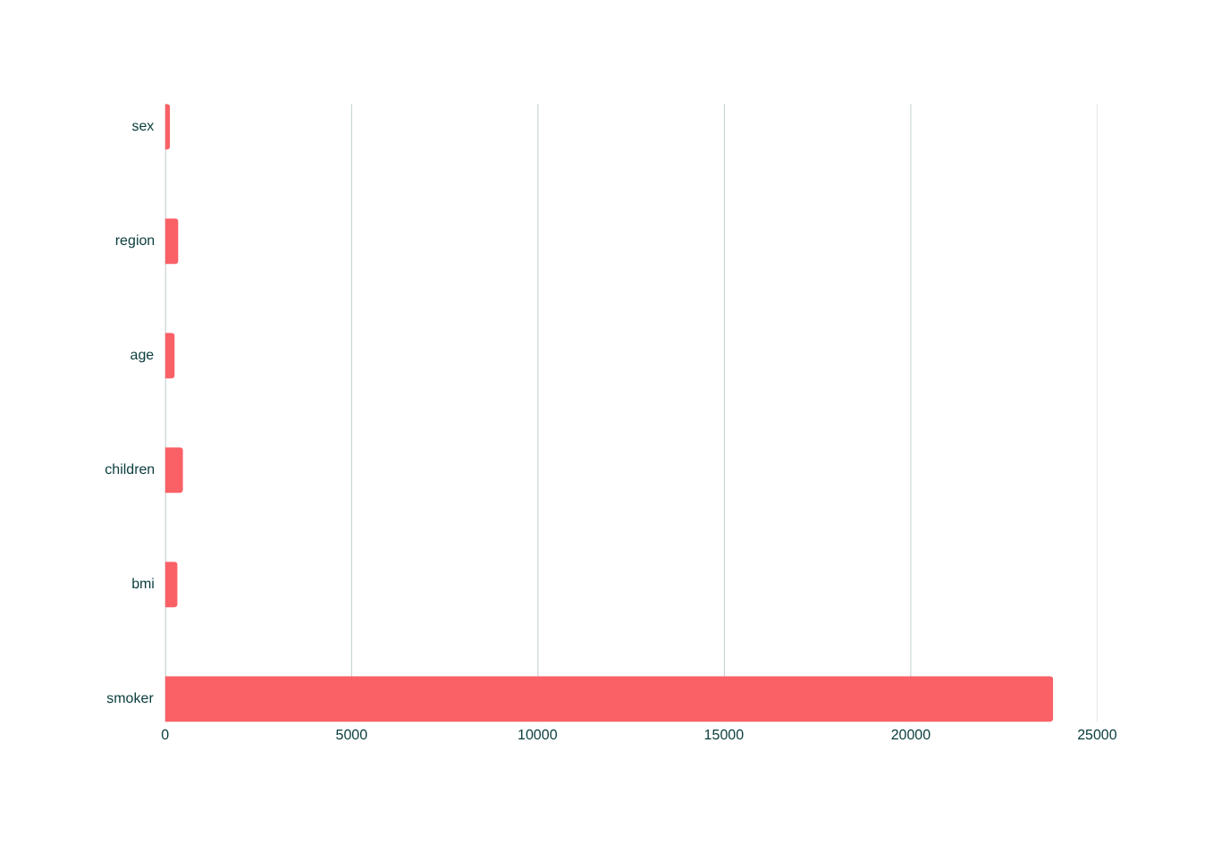
R² = 0.75
Regression Analysis
Charges = 257.29·age − 131.11·sex + 332.57·bmi + 479.37·children + 23,820.43·smoker − 353.64·region − 11,815.45
Smoker +$23,820
Largest cost driver by far
BMI +$332.57
Higher BMI raises costs
Age +$257.29
Older → higher charges

Slide 5
Optimization Formulation
Decision Vector: x = [age, sex, bmi, children, smoker, region]ᵀ
Variable | Constraint | Justification
x₁ Age | 18 ≤ x₁ ≤ 64 | Working-age adults eligible for insurance
x₂ Sex | 0 ≤ x₂ ≤ 1 | Binary: 0 = female, 1 = male
x₃ BMI | 18.5 ≤ x₃ ≤ 30 | Healthy BMI range per WHO classification
x₄ Children | 0 ≤ x₄ ≤ 5 | Observed range in dataset
x₅ Smoker | x₅ = 0 | Non-smoker policy enforced to minimize risk
x₆ Region | 0 ≤ x₆ ≤ 3 | Four-region encoding (NE, NW, SE, SW)

Slide 6
Optimization Results
Problem 1 — Minimize Charges
Problem 2 — Maximize Profit
(Linear Programming)
(Nonlinear — L-BFGS-B Solver)
Age:
18 years (youngest)
Predicted Charges:
~$0 (min risk profile)
Sex:
Male (lower charges)
Premium Charged:
$600 (base floor)
BMI:
18.5 (healthy minimum)
Max Expected Profit:
~$600 per patient
Children:
0 (no dependents)
Risk Level:
Minimal
Smoker:
No (fixed constraint)
Patient Profile:
Young, healthy, non-smoker
Region:
3 (max cost reduction)
Key Insight: Cost minimization and profit maximization lead to the same optimal patient profile.

Slide 7
Key Findings
🚬 Smoking is the #1 Cost Driver
⚖️ BMI & Age Compound Risk
Coefficient of +$23,820 — dwarfs all other features. Non-smoker policies alone cut predicted charges by over 60%.
Together they push charges higher; healthy BMI patients in younger age groups are the most profitable segment.
🎯 Optimal Patient Profile
💰 Profit Aligns with Risk Reduction
Non-smoking male, age 18, BMI 18.5, no children, Region 3 — minimizes predicted charges under the LP model.
Under the linear profit model, the charge-minimizing profile also maximizes expected profit.

Slide 8
Limitations & Future Directions
⚠ Limitations
🚀 Future Directions
  Linearity assumption may underfit non-linear cost curves
  LP minimum falls outside realistic ranges (need charge floor)
  Fixed bounds don't reflect evolving clinical guidelines
  No interaction terms (e.g., smoker × BMI) captured
  Non-linear models — XGBoost or Random Forest for better accuracy
  Stochastic optimization with chance constraints against cost swings
  Multi-objective optimization — cost, diversity, compliance
  Dynamic pricing using time-series risk profile adjustments

Slide 9
Conclusion & Impact
"Optimization is not just theory — it turns patient data into better, fair, and cost-aware healthcare decisions."
  Linear regression (R² = 0.75) successfully quantifies each cost driver's contribution
  Convex optimization yields a data-driven ideal patient profile and policy benchmark
  The framework is transparent, scalable, and actionable for real-world insurers
Risk Profiling
Premium Setting
Wellness Incentives
Automate patient risk scoring using regression coefficients
Risk-adjusted premiums based on quantified cost drivers
Smoking cessation & BMI programs reduce financial exposure

Slide 10
Thank You!
Questions & Discussion
Thangella Jeevantej | Mathematical modelling, Convex Formulation, Derivations
Ch Bavesh Sai Satya Prakash | Optimization algorithm, Implementation, Validation
Guravana Lakshmi Narayana Naidu | Data processing, Visualization, Insights
Code: github.com/CBSSP/Medical-cost-Optimizer

